Slide 1
Mandate 1.1 - Tutorial on Large Language Models
(Part II)
Author: Dhruv Awasthi

Slide 2
Quick Recap

Slide 3
Quick Recap
What is a Large Language Model (LLM)?
Capabilities of LLMs
Language models are their types
What makes language models “LARGE”?
Evolution of LLMs

Slide 4
Quick Recap
Setup and use OpenAI API
Available models and their use case
How to use OpenAI API for various tasks?
Various arguments supported by the OpenAI API
Prompt engineering
Elements of a prompt
Tips for designing prompts
Prompting techniques
Various prompting techniques in action

Slide 5
Why Open-Source?

Slide 6
Why Open-Source?
OpenAI LLM is a proprietary LLM - We do not have access to the code or it’s weights.
Privacy concerns - Whatever we upload is sent to the company.
Control - They have the control over all of the ecosystem, if tomorrow the service shuts down or they increase the usage fees, etc. the users using this will have no other choice/
License - Can be modified, improved, and used in a wide range of applications.
Freedom - We change the model as we want to, without any restrictions.
Transparency - Allow researchers and developers to understand the models’ working in detail.
Free for use.

Slide 7
LLaMA (Large Language Model Meta AI)

Slide 8
LLaMA
It is an open-source large language model developed by researchers at Meta.
It was first released in Feb, 2023 in the paper LLaMA: Open and Efficient Foundation Language Models.
LLaMA was made available in several sizes (7B, 13B, 33B, and 65B parameters).
It is also an auto-regressive language model, based on the transformer architecture.
It works by taking a sequence of work as input and predicts a next word to recursively generate the text.
The training dataset comprises of text from 20 languages.
LLaMA-13B outperforms GPT-3 (175B) on most benchmarks.

Slide 9
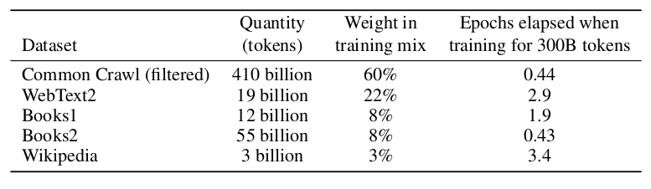
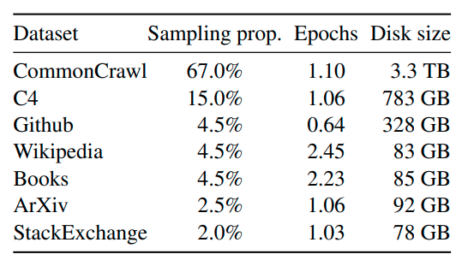
Training Dataset for GPT-3 vs LLaMA
Training Dataset for GPT-3
Training Dataset for LLaMA

Slide 10
Dataset Preparation
Deduplication of data
Language identification with a fastText linear classifier to remove non-English pages
Filter low quality content with an n-gram language model
For GitHub, only kept projects that are distributed under Apache, BSD, and MIT licenses.
Remove boilerplate codes, such as headers, with regular expressions
For Wikipedia, remove hyperlinks, comments, and other formatting boilerplate
For ArXiv, removed everything before first section, as well as bibliography
For Stack Exchange, kept data from 28 websites, removed HTML tags from text and sorted the answers by score

Slide 11
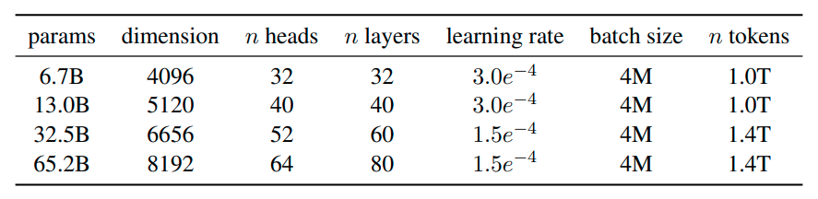
Model Size, Architecture & Optimization Hyperparameter
LLaMA-33B and LLaMA-65B were trained on 1.4T tokens while LLaMA-7B and LLaMA-13B were trained on 1.0T tokens.

Slide 12
LLaMA 2

Slide 13
LLaMA 2
This model was released in July, 2023 in the paper Llama 2: Open Foundation and Fine-Tuned Chat Models.
Released a fine-tuned LLM called LLaMA2-Chat, optimized for dialogue use cases.
Released Code LLaMA, state-of-the-art LLM capable of generating code, and natural language about code, from both code and natural language prompts.
Code LLaMA, foundational code model
Code LLaMA Python, specialized for Python
Code LLaMA Instruct, fine-tuned for understanding natural language instructions
The code for LLaMA 2 is available here.

Slide 14
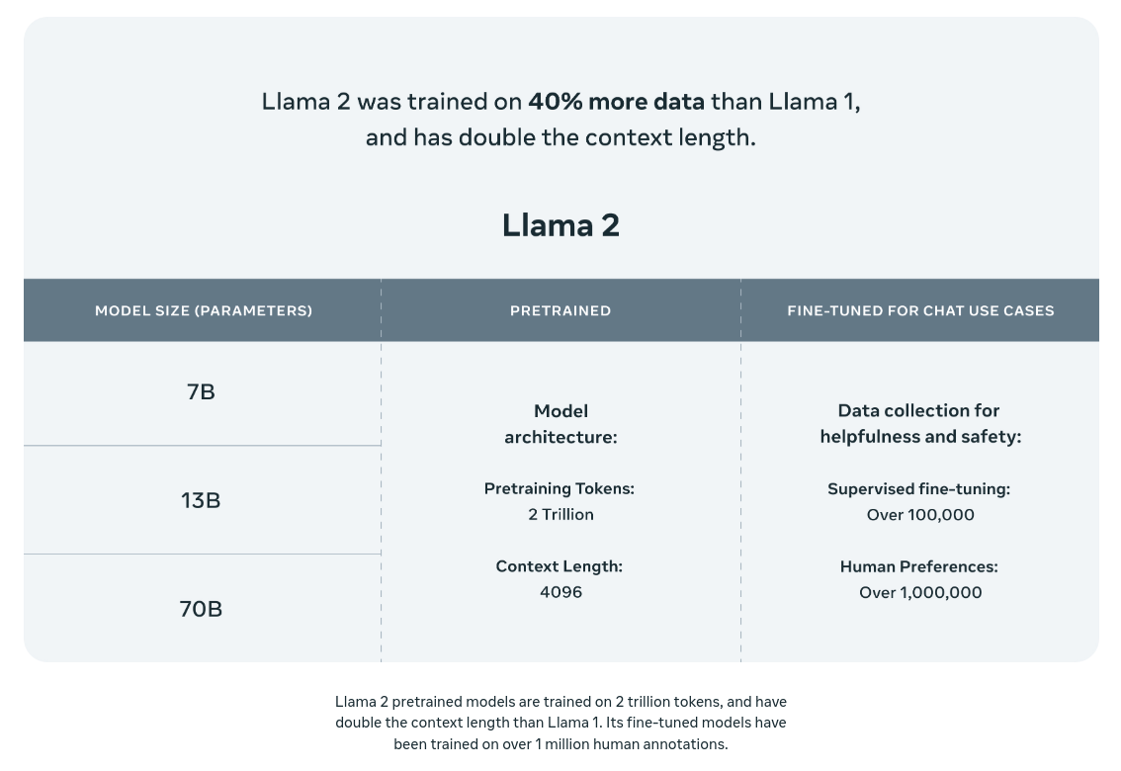

Slide 15
Getting Started with LLaMA 2!

Slide 16
Limitations of Large Language Models (LLMs)

Slide 17
Limitations of Large Language Models (LLMs)
Hallucinations
Potential Bias in Training Data
Visual Question Answering
Text Representation in Images
Interpretability
Data Privacy

Slide 18
Limitations of Large Language Models (LLMs)
Real Time Information
Compute Intensive
Inference Time and Cost
Longer Conext
Prompt Injection
Non Deterministic Outputs

Slide 19
Safety of LLMs

Slide 20
Case Study 1: Access Sensitive Information using Prompt Engineering

Slide 21
Case Study 2:
How-To’s on Illegal Activities

Slide 22
Case Study 3:
Automated Content Generation for Manipulative Purposes

Slide 23
Case Study 4:
Deepfakes

Slide 24
Case Study 5:
Hallucinations

Slide 25
Thank you!
Questions please?

